Slide 1

CSCI 297: Generative AI: Creating with Computation
Introduction

Slide 2
What is Learning?
Learning is the process of acquiring new understanding, knowledge, behaviors, skills, values, attitudes, and preferences. The ability to learn is possessed by humans, animals, and some machines; there is also evidence for some kind of learning in certain plants.
Some learning is immediate, induced by a single event (e.g. being burned by a hot stove), but much skill and knowledge accumulate from repeated experiences. The changes induced by learning often last a lifetime, and it is hard to distinguish learned material that seems to be "lost" from that which cannot be retrieved.

Slide 3




What can we learn from?
Complex and unstructured data from the internet, repositories and databases
How do we understand these complex and unstructured inputs
Images Natural Language Computational Speech Robotics

Slide 4
Idea behind GenAI
“What I understand, I can also create”
GenAI cannot synthesize something from nothing, it find a distribution of data and pulls from that same distribution
It must learn that distribution from observing many examples

Slide 5
What is Machine Learning?
Machine Learning is the science of getting computers to learn and act like humans do, and improve their learning over time in autonomous fashion, by feeding them data and information in the form of observations and real-world interactions.

Slide 6
Why do we need Machine Learning?
Processing speed
Pattern recognition
Pattern identification (nothing humans couldn’t find)
Let's try and example…half of class close your eyes

Slide 7
Traditional Programming
Data
Machine
Output
Program
Machine Learning
Data
Machine
Program
Output

Slide 8
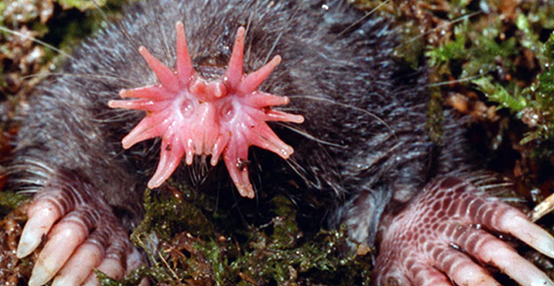

Describe this animal…

Slide 9
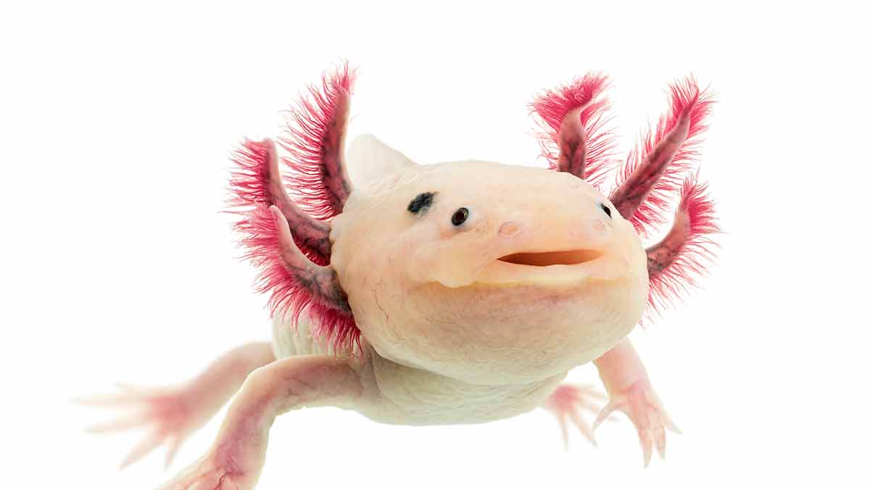
Describe this animal…

Slide 10

So, what is AI?
AI is the theory and development of computer systems capable of performing tasks typically requiring human-level intelligence.

Slide 11
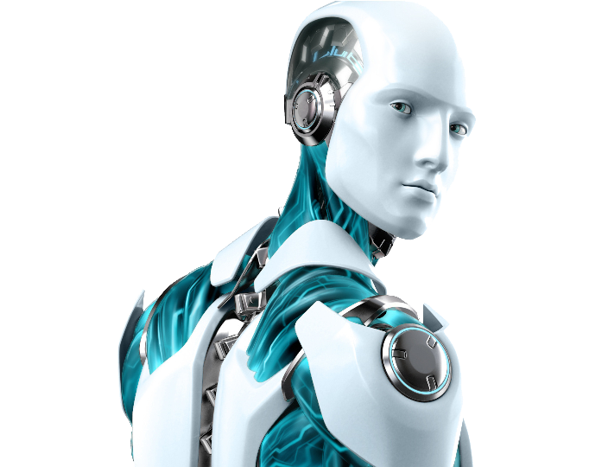

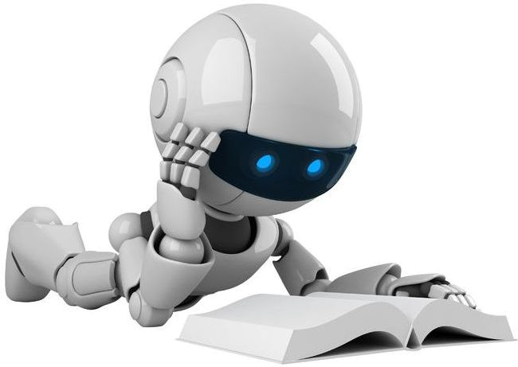
AI does not equal ML
Artificial Intelligence​
Machine Learning​​

Slide 12
Hierarchy of Learning
AI
ML
DL
Gen AI
Artificial Intelligence
is a discipline​
Machine Learning
is a subfield​​

Slide 13
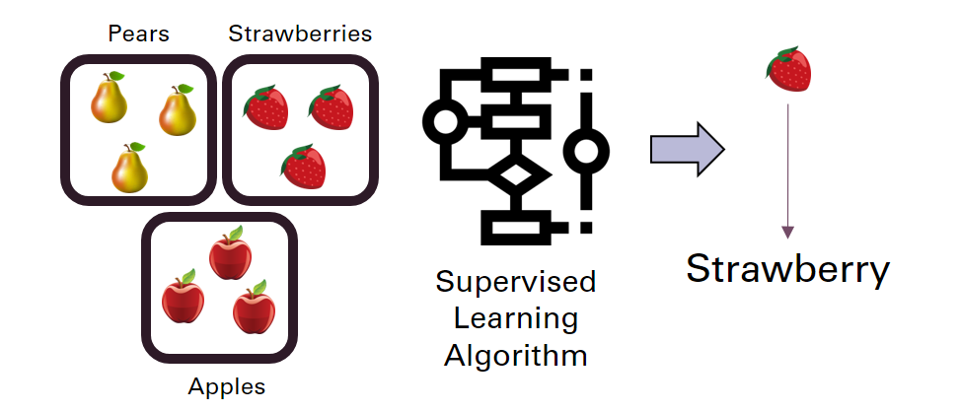
Types of Learning: Supervised Learning
Learns from data which is labeled​
Learns to associate that type of data with the label

Slide 14
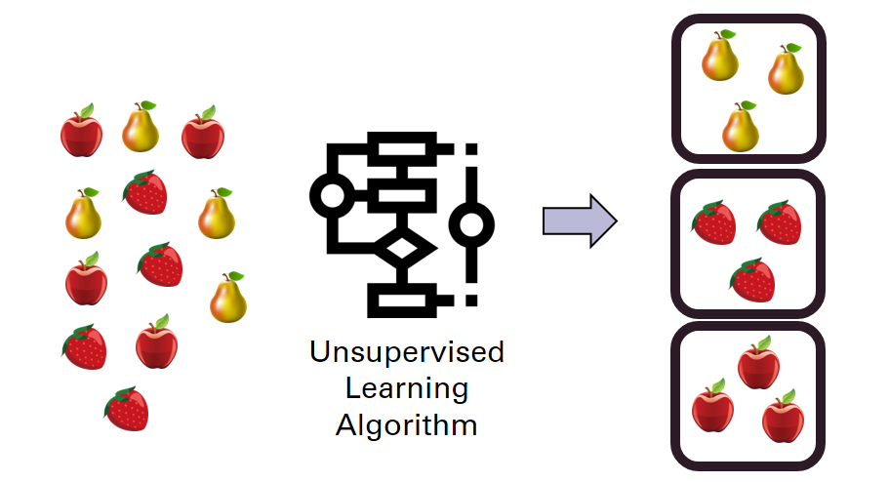
Types of Learning: Unsupervised Learning
Learns from data which is not labeled​
Learns to cluster similar types of data together

Slide 15
Other Types of Learning
Semi-supervised and Reinforcement learning are two other types of learning we won’t cover much in this course
Semi-supervised learning learns to label data from only having a few labeled examples
Reinforcement learning learns a behavior based on a reward function, this is used in video games and robotics

Slide 16
Elements of Learning
The elements of learning are a guiding principle that outline the necessary components for any learning algorithm to be successful.
These were pioneered by Abu Mustafa, a significant figure in AI
Input
Output
Target Function
Data
Hypothesis

Slide 17
Diagram of Learning
Unknown Target Function
F: X -> Y
Ideal function that we are estimating
Training Examples
(x1, y1), (x2, y2), … , (xn, yn)
Historical records of information
Our best estimation of the unknown target function
Learning Algorithm
A
Final Hypothesis
G ~= F
Hypothesis Set
H
Set of candidate formulas determined by the algorithm

Slide 18
Within Your Control
The learning algorithm and hypothesis set
You should understand the strengths and weaknesses of every algorithm
This boils down to how you wish to limit your hypothesis set.
The data you use (bias, skewed, up/down sampling)

Slide 19
Out of Your Control
You cannot control the target function
You cannot control the data – this is given to you or needs to be extracted

